Slide 1
Building energy forecast
Springboard data science capstone project #2
Prepared by Mike (Xiangnan) Shi
Mentor: Blake arensdorf

Slide 2
Outline
Project overview
Problem statement
Data wrangling and exploratory data analysis
Modeling
Summary
Future research

Slide 3
Project overview
Goal: Develop a model to forecast energy consumption in a building.
Tool: Python, Jupyter Notebook
Workflow:
Define the problem
Collect, clean and explore the data
Create and train models based on training set
Validate the models using test set and evaluate the performance

Slide 4
Problem statement

Slide 5
Problem statement
Context:
Given a building’s daily energy consumption in the first three quarters, what is the daily energy usage forecast in the fourth quarter?
Stakeholders:
Building owners, building managers and operators, financial and accounting department
Scope of solution
Build models that can take historical energy consumption as input and forecast future consumption
Try different models including time series and random forest
Compare the performance of different models and determine a model that best fits in the goal.
Data:
Source: https://www.kaggle.com/c/ashrae-energy-prediction/data

Slide 6
Data wrangling and exploratory data analysis (EDA)

Slide 7
Data overview
Data source: https://www.kaggle.com/c/ashrae-energy-prediction/data
Data time span: 2016/1/1 – 2016/12/31
Target: electricity usage (meter_reading)
Features used in the study: Timestamp, air temperature, dew point temperature
Data relationships:
Energy_data
Buliding_id
Meter
Building_metadata
Site_id
building_id
Weather
Site_id
Timestamp
Timestamp
Meter_reading
Primary_use
Square_feet
…
Air_temperature
Dew_point_temperature
…

Slide 8
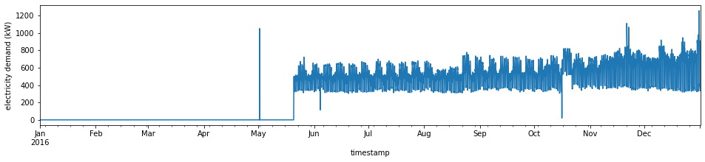
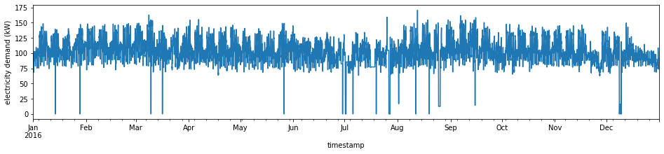
Data errors and cleaning
Types of data errors
Zero readings
Extended periods of zero readings are considered as errors as building electricity rarely drops to zero. Those values are dropped out.
Anomalies
Abnormal electricity swings are considered sensor issues and dropped out as well.

Slide 9
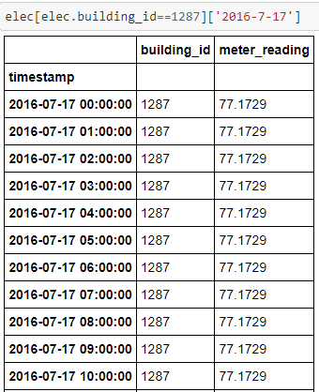
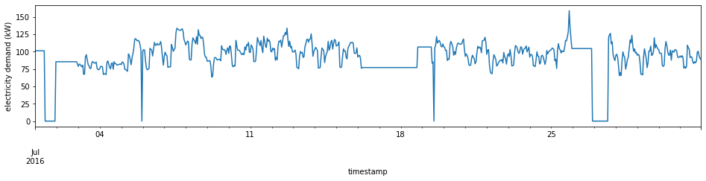
Data errors and cleaning
Types of data errors
Frozen readings
Frozen readings are considered sensor failures and are dropped out as well.

Slide 10
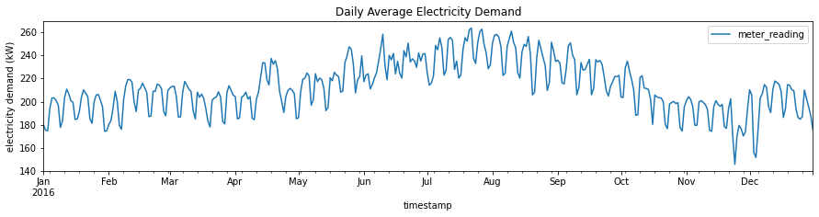
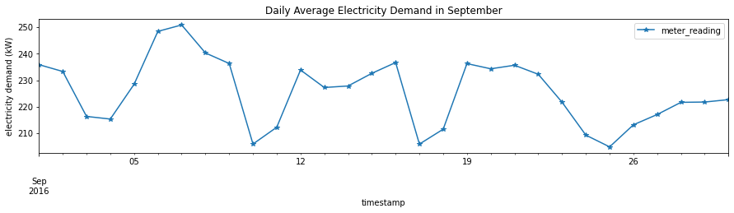
EDA
The electricity usage appears higher in summer. This is likely due to more AC usage during that time.
There appears to be a regular fluctuation on a weekly basis. The electricity usage tends drop over the weekend and come back on weekdays.

Slide 11
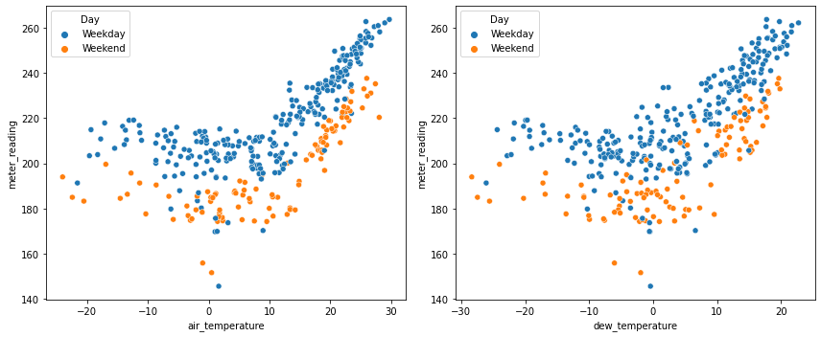
EDA
When the air temperature and dew point temperature are above a threshold, the electricity usage starts to increase in correlation with those temperatures.

Slide 12
Modeling

Slide 13

modeling
Training / Test data split
Training: Jan – Sep
Test: Oct – Dec
Models
Time Series
ARIMA
SARIMA
SARIMA with rolling forecast
SARIMAX with rolling forecast
Random forest
Metrics
R squared
Mean Absolute Error (MAE)

Slide 14
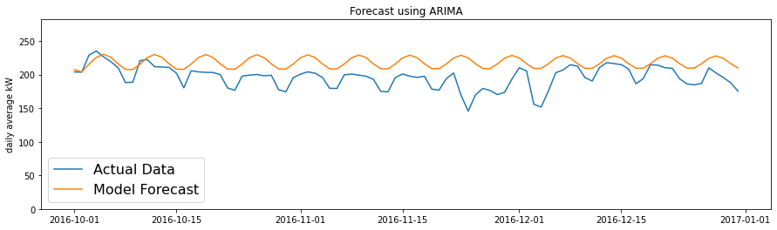
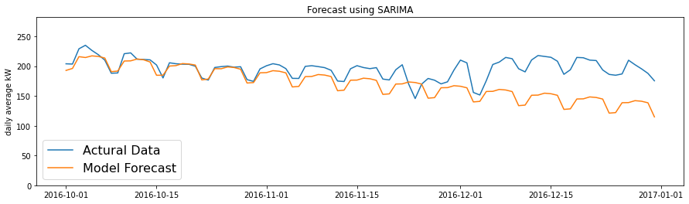
ARIMA and SARIMA
ARIMA
Optimal order is (2,1,5) based on auto arima search.
R²: -10.95; MAE: 22.73
It’s able to simulate the fluctuation patten, but the shape isn’t quite right.
SARIMA
Added seasonality into the model
Optimal order is (5,1,0)(2,1,0)[7] based on auto arima search.
R²: -0.81; MAE: 25.5
The shape of forecast is much closer to actual data, but it mistakenly picks up a downward trend.

Slide 15
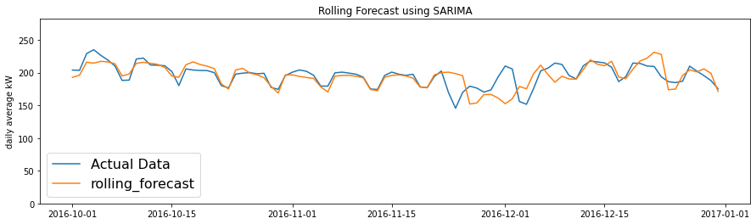
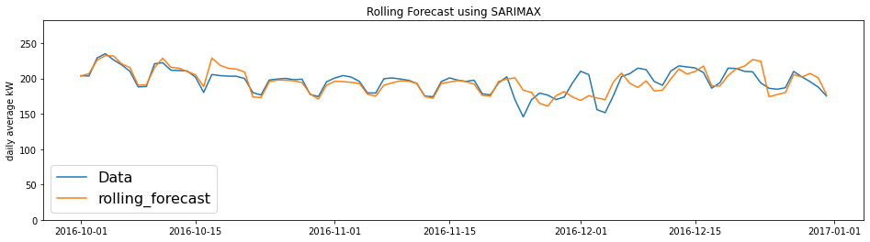
Rolling forecast using sarima and sarimax
SARIMA with rolling forecast
Instead of a three month forecast at one time, weekly forecasts are done in a rolling manner.
R²: 0.25; MAE: 9.84
It fixed the downward trend from last model.
SARIMAX with rolling forecast
Added holiday schedule and temperatures into the model as exogenous inputs
R²: 0.52; MAE: 8.23
The accuracy improved slightly

Slide 16
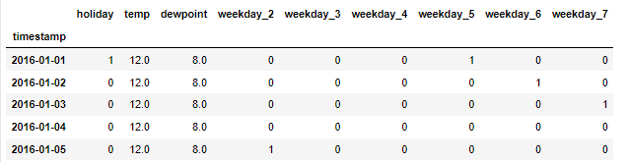
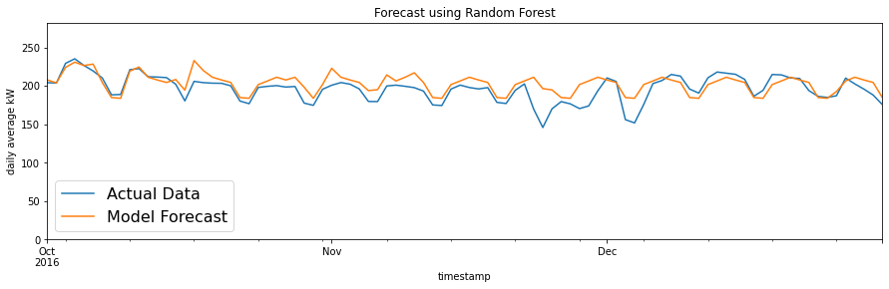
Random forest
Training data set
Features:
Holiday
Day of week
Air temperature and dew point temperature
Grid search
A grid search is performed to find an optimal number of trees to be used, which turns out to be 10.
Result
R2: 0.39; MAE: 9.93

Slide 17
summary
In this project, ARIMA and SARIMA don't seem to perform well enough for a one-time long term forecast. The models tend to pick up a trend from prior steps and assume the trend will continue in the future. As a result, the forecast is very sensitive to the last few steps in the train data set.
Time series models perform much better forecast if done in a rolling manner, which is more focused on short term forecast.
Adding exogenous features, such as holiday schedule, weather data in this case can improve the accuracy of time series models.
Random forecast can be an alternative solution to consider if a one-time long term type forecast is needed.
Model | R Squared | MAE
Basic ARIMA | -10.95 | 22.73
SARIMA | -0.81 | 25.5
SARIMA with rolling forecast | 0.25 | 9.84
SARIMAX with rolling forecast and exogenous inputs | 0.52 | 8.23
Random Forest | 0.39 | 9.93

Slide 18
FUTURE research
Additional features outside the data set may be explored and integrated into the models, such as building occupancy.
Additional models such as neural networks can be explored as well.
If the training data set can expand to at least a whole year, it may make the model more robust.

Slide 19


Contact
LinkedIn https://www.linkedin.com/in/mike-shi-pe-cem-14029a26/
GitHub https://github.com/stonewatertx
Email stonewatertx@email.com

